Slide 1
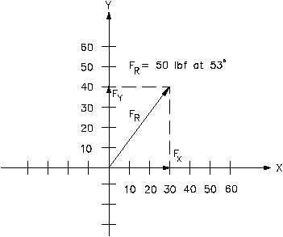
Algebraic Methods
This lesson will extend your knowledge of kinematics to two dimensions
You will be able to solve problems involving kinematics problems in two dimensions using the trigonometric method and the component method

Slide 2
Learning Goals
By the end of this lesson, you will be able to:
add vectors in two dimensions using the two algebraic methods
use vector addition to solve kinematics problems for displacement and velocity

Slide 3
Success Criteria
Can I:
add vectors in two dimensions using the trigonometric method
add vectors in two dimensions using the component method
solve for displacement and velocity in two dimensions using any of the three methods.

Slide 4
Trigonometric Method
Let’s solve yesterdays hiker question using the
trigonometric method.
Sol’n:
24 km
This is the diagram
after we apply vector
addition
60.º
21 km
Next we break the
vector diagram into
triangles
15 km

Slide 5
We apply cosine law
to solve for the
unknown side
60.º
24 km
60.º
21 km
a

Slide 6
We apply sine law
to solve for the
angles
60.º
24 km
60.º
21 km
θ
22.65 km

Slide 7
We apply cosine law
again to solve for the
final answer
60.º
24 km
60.º
21 km
53.4º
22.65 km
66.6º
15 km

Slide 8
We apply sine law
again to solve for the
final angle
60.º
24 km
60.º
21 km
53.4º
22.65 km
66.6º
15 km
21.6 km
θ
∴ Δd = 22 km [N74ºW]

Slide 9
component Method
every vector consists of two components.
vector components are ⊥ to each other
vector components
add together to form
the vector
a
a_{y} = a sinθ
θ
a_{x} = a cosθ

Slide 10
Now let’s solve use the component method.
Sol’n:
First, we break each vector down into its components
We will pick N,E as +’ve and S,W as –’ve
60º

Slide 11
Then we add the x and y comp’s separately

Slide 12
Next we draw the comp’s head to tail and use the Pythagorean Theorem
+6.0 km
θ
-20.78 km
∴ Δd = 22 km [W16ºN]

Slide 13
HOMEWORK
Read Section 2.2
Review Tutorial 1 – 4
Questions 1 – 2 pg 67
1 – 2 pg 69
1 – 2 pg 71
1 – 2 pg 74

